Slide 1
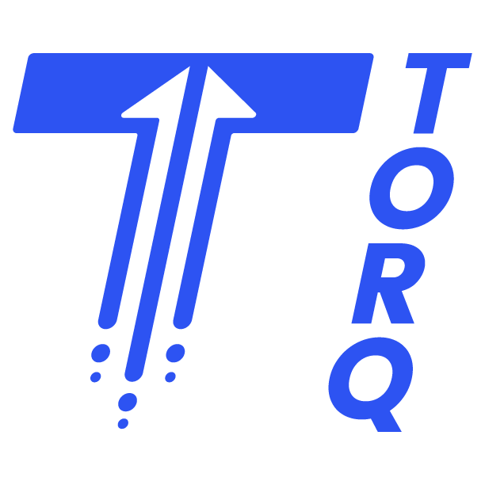
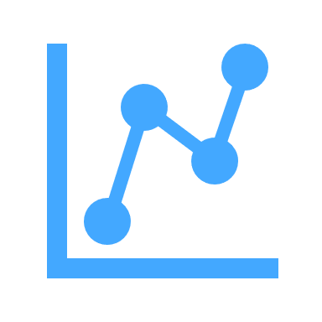
Understanding data shouldn’t be hard.
What we do.
Break down cross-functional barriers with Torq and work across the data pipeline – from source to consumption – to deliver fast, accurate, and actionable insights for your organization.
DATA STRATEGY & ARCHITECTURE
DATA ENGINEERING & DELIVERY
MODERN BI & ANALYTICS
Program Strategy
Cloud Migration
Architecture Design
Implementation Planning
Platform Configuration
Data Structuring
Data Integration
Data Ops & Governance
Data Discovery
Data Visualization
Dashboard Development
Automated Reporting
Email hello@gotorq.com Call or Text 214.564.8327 Connect www.linkedin.com/company/gotorq
DID YOU KNOW?
GET IN TOUCH
ADVANCED AI & AUTOMATION
FRACTIONAL
CDO
Our services can be bundled and customized to meet the exact needs of your business.
Data Science
Predictive Analytics
Machine Learning
Process Automation
Management Review
Enterprise Governance
Enterprise Dashboarding
Data Ecosystem Servicing
Data & Analytics expertise you can trust.
Don’t take our word for it.
Michael Varraveto Practice Director, Insight With nearly a decade of “big consulting” experience in data and analytics, Mike leads our venerable Insight practice at Torq.
“
Torq’s data & analytics consultants are great to work with – and they work quickly too! Group Manager Fortune 500 Automotive Company
92%
Torq has happy clients – our lifetime contract renewal rate is over 90%

